Slide 1
Deep Learning - Introduction

Slide 2
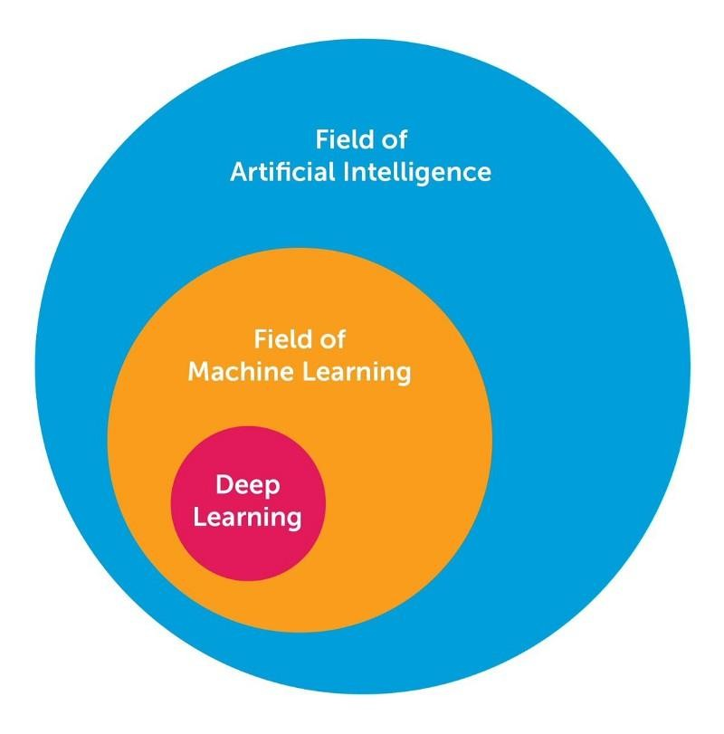
Introduction
AI, ML and DL
Deep Learning is a subset of Machine Learning, which on the other hand is a subset of Artificial Intelligence. Artificial Intelligence is a general term that refers to techniques that enable computers to mimic human behavior. Machine Learning represents a set of algorithms trained on data that make all of this possible. Deep Learning, on the other hand, is just a type of Machine Learning, inspired by the structure of a human brain. Deep learning algorithms attempt to draw similar conclusions as humans would by continually analyzing data with a given logical structure. To achieve this, deep learning uses a multi-layered structure of algorithms called neural networks.

Slide 3
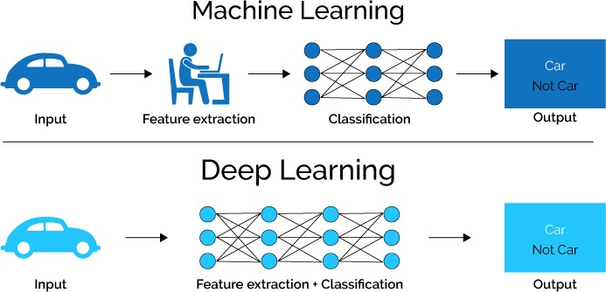
The design of the neural network is based on the structure of the human brain. Just as we use our brains to identify patterns and classify different types of information, neural networks can be taught to perform the same tasks on data.
Advantages of DL
The first advantage of deep learning over machine learning is the needlessness of the so-called feature extraction. - Feature Extraction is usually quite complex and requires detailed knowledge of the problem domain. This preprocessing layer must be adapted, tested and refined over several iterations for optimal results.
Big Data Era- Deep Learning models tend to increase their accuracy with the increasing amount of training data, where’s traditional machine learning models such as SVM and Naive Bayes classifier stop improving after a saturation point

Slide 4
Major Architectures of Deep Networks
Four Major Architectures:
Unsupervised Pretrained Networks (UPNs)
Convolutional Neural Networks (CNNs)
Recurrent Neural Networks
Recursive Neural Networks

Slide 5
Major Architectures of Deep Networks
Unsupervised Pretrained Networks (UPNs)
Autoencoders
Deep Belief Networks (DBNs)
Generative Adversarial Networks (GANs)
Use Cases:
Feature Extraction
Initialization
Synthesizing

Slide 6
Major Architectures of Deep Networks
Convolutional Neural Networks (CNNs)
Lenet-5
AlexNet
VGGNet
GoogleNet (Inception)
ResNet
ResNext
DenseNet
RCNN (Region Based CNN)
YOLO (You Only Look Once)
SqueezeNet
SegNet
Use Cases:
Computer Vision
Natural Language Processing

Slide 7
Major Architectures of Deep Networks
3. Recurrent Neural Networks
Hopfield Network
Long Short-Term Memory (LSTM)
Gated Recurrent Unit (GRU)
Use Cases:
Sentiment Classification
Image Captioning
Language Translation
Video Captioning

Slide 8
Major Architectures of Deep Networks
Recursive Neural Networks
Recursive Autoencoder
Recursive Neural Tensor Network
Use Cases:
Image scene decomposition
NLP
Audio-to-text transcription

Slide 9
References
https://www.simplilearn.com/tutorials/deep-learning-tutorial/deep-learning-algorithm
https://towardsdatascience.com/what-is-deep-learning-and-how-does-it-work-2ce44bb692ac
https://semiengineering.com/deep-learning-spreads/
https://www.safaribooksonline.com/library/view/deep-learning/9781491924570/ch04.html

